Slide 1
G
Greg Marsello
Learning Resources Network
Vice President of Organizational Development

Slide 2
Resiliency Strategies
Taking care of yourself
Taking care of your continuing education unit
Taking care of continuing education

Slide 3
??????????

Slide 5
The Challenges
Higher expectations
Reduced resources
Central administration shifts
Competition
Work/life balance

Slide 6
Taking Care of Yourself
keep it in perspective--it's work, not life
everyone else is in the same boat, so you have company
make small, continuous, manageable changes
keep improving yourself and your skills
make time to rest and work differently (telecommuting)
have a support network
change what you can and figure out ways to minimize the impact of the rest
know your resources (people, programs, etc.)
track the positive, too (know what's changing, what little progresses are made, positive impact you may have had, even in a negative or challenging situation)

Slide 7
Taking Care of Your Continuing Education Unit
connect with the PEOPLE, they are human beings
work with the willing to create positive change--this will not always include everyone, but stay focused on those who WANT to change
know your goals
know your priorities
create a plan
know what's possible and what's not
improve in small, continuous ways
broadcast your success
dissect every failure to learn as much as you can

Slide 8
Taking Care of Continuing Education
You can’t be everything to everybody
Be customer managers, not product managers
Think customer share, not market share
You must be financially self-sufficient
Collect and analyze data to make data-driven decisions…numbers are your friends
Reduce meetings by using technology
Streamline catalog/promotion production
Cut the dogs!
Have a one-year business plan
Be essential

Slide 9
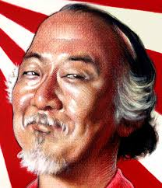
Greg Marsello, LERN
marsello@LERN.org

